Slide 1


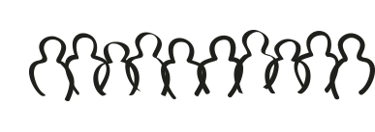


Notes:
NOTE: This presentation uses animations. Run the 1 minute presentation as a slideshow in order to see the animations properly.
Our dream technology, is a technology which will reduce queues at stores, supermarkets, airports and any other place where queuing is an everyday occurrence.

Slide 2

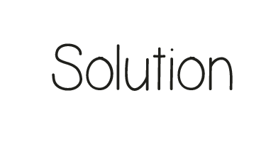
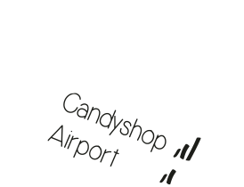
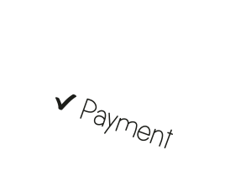
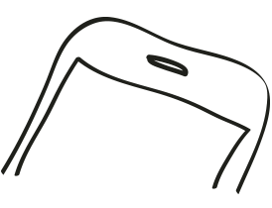
Notes:
An mobile application that an user can choose to use. The user can automatically pay for his products when walking out of the store and advise users what the best time is for them to arrive at a store to avoid crowds.

Slide 3
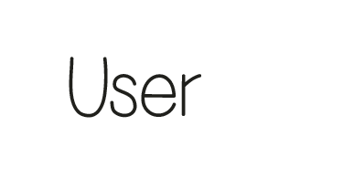


Notes:
Benefits for the user is that they have a overall better shopping experience, because they don’t have to wait, it’s not crowded in the shops, you don’t bump into other persons.

Slide 4


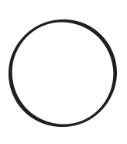
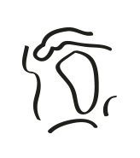
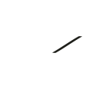
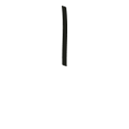
Notes:
Society is in general happier because they spent less time waiting and have more time to be for example at their friends and family

Slide 5


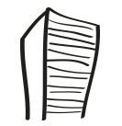
Notes:
Enterprise can lower the amount of employees an maybe even the size of the building, so the enterprise can make more profit

Slide 6
Notes:
Next follows the 5 minute presentation, without animations

Slide 7
Dream:
Reduce queues
at places where queuing is an everyday occurrence
Redesigned:
Prevent queues
at places where queuing is an everyday occurrence
Notes:
Our dream was first to reduce queues in for example supermarkets, airports and any other place where queuing is an everyday occurrence. But then we realized that being in a queue doesn’t make anybody happier, so why should we be in queues in the first place? Can we find a solution so queues don’t have to occur anymore making everybody more happy.

Slide 8
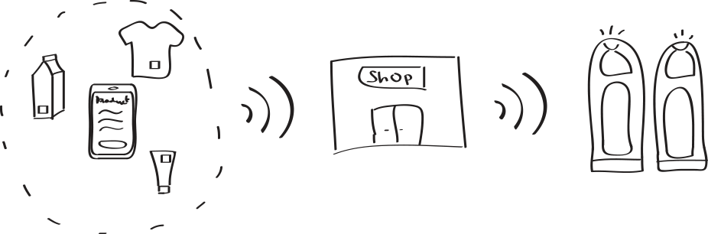
Notes:
When entering a shop you open the app on your mobile phone in order to let your phone track the products you pick. The app is smart enough distinguish the products that move along with you and the stationary objects by an induction sticker that is on the product. When you are done shopping, you check the list of products and if all the products are recognized. You confirm that all the products are tracked and click to pay on your mobile phone. Your phones sends the message to the shop that you have paid for that specific list of products and sends a message to the security towers that they temporarily don’t have to beep when that products pass by.

Slide 9
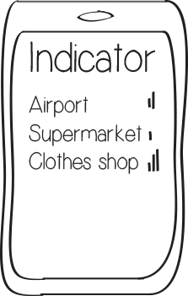
Notes:
Also you can use the app to indicate how busy it is in certain places….(More explination, Max)

Slide 10
Notes:
An mobile application that an user can choose to use. The user can automatically pay for his products when walking out of the store and advise users what the best time is for them to arrive at a store to avoid crowds.

Slide 11
Notes:
Privacy problems

Slide 12
Notes:
Ap

